Slide 1
Linux :
Linux is an open-source Unix-like operating system based on the Linux kernel, an operating system kernel first released on September 17, 1991, by Linus Torvalds. Linux is typically packaged as a Linux distribution. Wikipedia
Initial release date: 17 September 1991
Developer: Linus Torvalds
Original author: Linus Torvalds
Programming languages: C, Assembly language
Update methods: KernelCare, dpkg, GNOME Software
Linux is a Unix-like, open source and community-developed operating system (OS) for computers, servers, mainframes, mobile devices and embedded devices. It is supported on almost every major computer platform, including x86, ARM and SPARC, making it one of the most widely supported operating systems.

Slide 2
Every version of the Linux OS manages hardware resources, launches and handles applications, and provides some form of user interface. The enormous community for developers and wide range of distributions means that a Linux version is available for almost any task, and Linux has penetrated many areas of computing.
For example, Linux has emerged as a popular OS for web servers such as Apache, as well as for network operations, scientific computing tasks that require huge compute clusters, running databases, desktop and endpoint computing, and running mobile devices with OS versions like Android.

Slide 3
File Permissions:
Nine characters denotes the three types of permissions.
Read (r) : The read permission allows you to open and read the content of a file. ...
Write (w) : The write permission allows you to edit, remove or rename a file. ...
Execute (x): In Unix type system, you can't run or execute a program unless execute permission is set.
What is the meaning of chmod 777?
The command chmod -R 777 / makes every single file on the system under / (root) have rwxrwxrwx permissions. This is equivalent to allowing ALL users read/write/execute permissions
To modify or change user permission we use the below command
Chmod 777
Owner Group others(user)
7 7 7
r+w+x
r—4,w—2,x—1 (4+2+1=7)

Slide 4
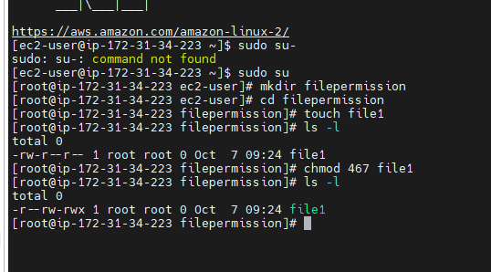
Logic.sh : Logics of our project owner(root)-Read (r)—4 Group(Read and write)—(r+w)-4+2=6 other(Execute)(x)--1
For an example if we need to check permissions ,create an instance with the public ip of an instance open the mobaxterm and check for the permissions in details
Ex: chmod 467 file1

Slide 5
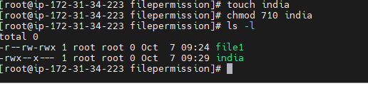
Now lets check another example create a file name India,for owner give permissions (rwx),for groups (x) and or for others(zero permissions)
So the command what we use for this file is
Chmod 710 india

Slide 6
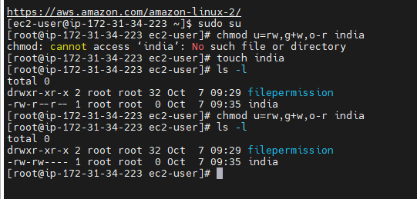
Now there is also second method to give permissions to the file with the help of alphabets . So to the file we can give file permissions in 2 methods 1 is numeric way and other is in alphabetical way. Below is the example for alphabetical order file pemission to the file India:

Slide 7
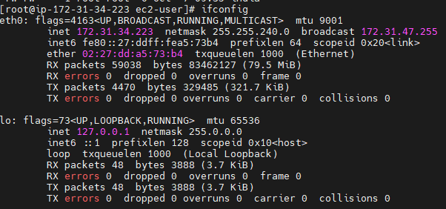
Networking commands : These commands are used to check the respective network related data.
Ifconfig: to check ip address ,mac address,mtu(Maximum Transmission units)

Slide 8
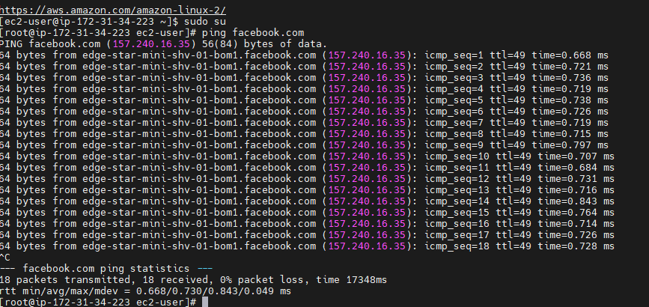
Ping <application name>:ping is a computer network administration software utility used to test the reachability of a host on an Internet Protocol network. It is available for virtually all operating systems that have networking capability, including most embedded network administration software.
PING (Packet Internet Groper) command is used to check the network connectivity between host and server/host. This command takes as input the IP address or the URL and sends a data packet to the specified address with the message “PING” and get a response from the server/host this time is recorded which is called latency. Fast ping low latency means faster connection.
Ex: ping facebook.com

Slide 9
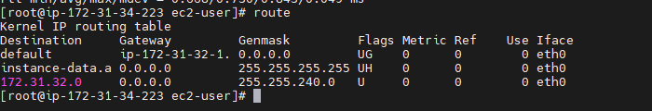
Route Command: route command in Linux is used when you want to work with the IP/kernel routing table. It is mainly used to set up static routes to specific hosts or networks via an interface. It is used for showing or update the IP/kernel routing table.

Slide 10
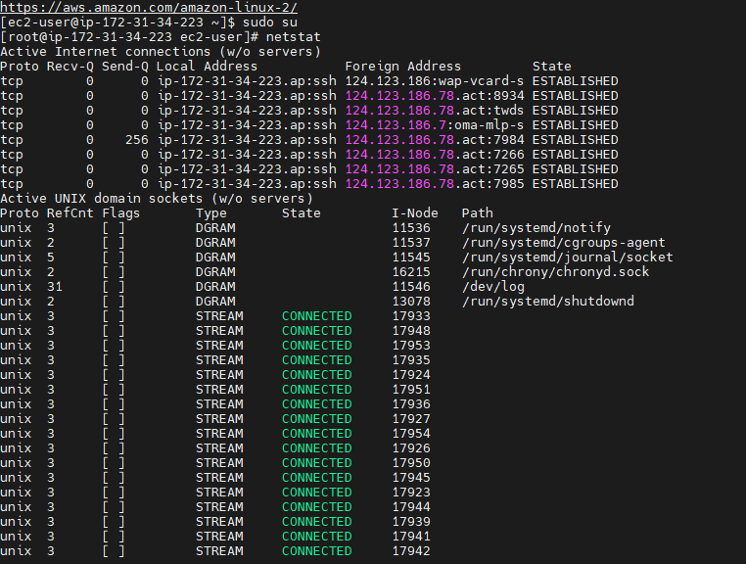
The network statistics ( netstat ) command is a networking tool used for troubleshooting and configuration, that can also serve as a monitoring tool for connections over the network. Both incoming and outgoing connections, routing tables, port listening, and usage statistics are common uses for this command.

Slide 11
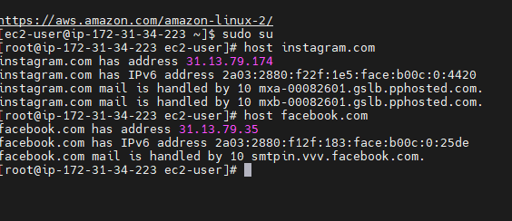
host command in Linux system is used for DNS (Domain Name System) lookup operations. In simple words, this command is used to find the IP address of a particular domain name or if you want to find out the domain name of a particular IP address the host command becomes handy
Ex : Host Instagram.com
Host facebook.com

Slide 12
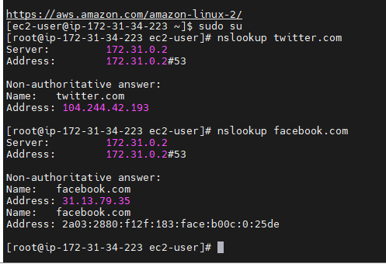
NS lookup :Nslookup (stands for “Name Server Lookup”) is a useful command for getting information from the DNS server. It is a network administration tool for querying the Domain Name System (DNS) to obtain domain name or IP address mapping or any other specific DNS record. It is also used to troubleshoot DNS-related problems.
Ex: nslookup twitter.com
nslookup facebook.com

Slide 13
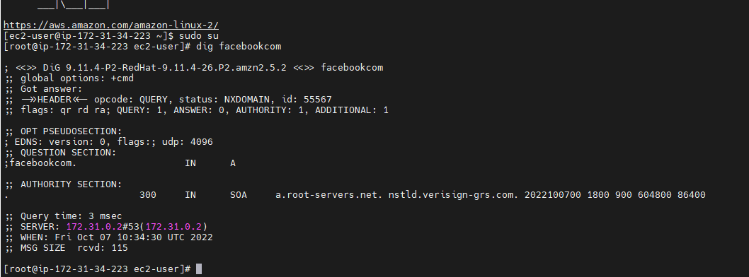
Dig command in Linux :The dig command in Linux is used to gather DNS information. It stands for Domain Information Groper, and it collects data about Domain Name Servers. The dig command is helpful for troubleshooting DNS problems, but is also used to display DNS information.
For example : dig facebook.com

Slide 14
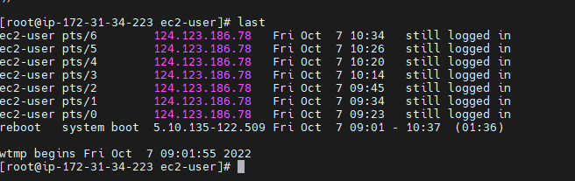
The last command displays information about the last logged-in users. It's pretty convenient and handy when we need to track login activities or investigate a possible security breach. The last command will, by default, take the system log file /var/log/wtmp as the data source to generate reports.

Slide 15
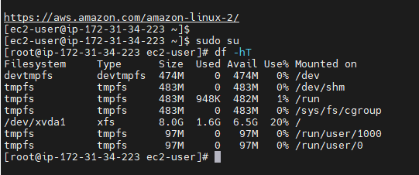
Disk Utilities make it easy for system administrators to easily monitor and manage disk partitions in Linux. In this article, we will look at the most popular disk utilities in Linux. Most of them are available in almost every Linux distribution, by default.
Df -Ht: This command will display the information in human readable language.

Slide 16
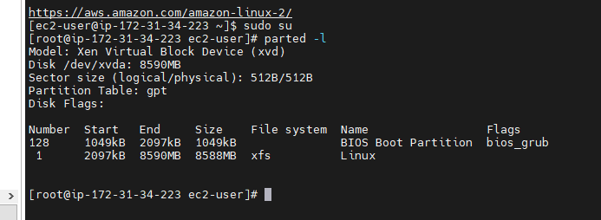
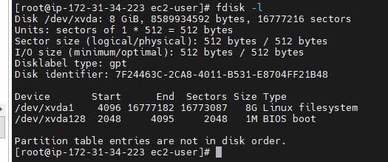
Parted -l : This command helps to create ,reorganize the block,copy the diska data etc.
fdisk –l: This command helps to create and manage disk partitions.

Slide 17

lsblk(list block): mounted,block devices ,names,mount points:
blkid(Block id): This shows us the block devices or partition names,labels,filesystem,uuid info.

